Slide 1
Is It Ethical For Organisations To Use Generative AI?
Torin, Tim, Sean, and Valentino

Slide 2

What is Generative AI and How is it Trained?
Generative Artificial Intelligence or GEN AI has a variety of applications.
A common example that everyone knows exists is the use of generative AI for the generation of digital visualisations like photos and video.
The image here was created with Dall-e using the prompt “How would you display yourself to an audience”.
Different versions of GEN AI are called models. Models focus on different aspect of creation with different skill sets.

Slide 3
Popular Gen AI Models
Generative Material Type | LLM Type | Capabilities | Risks
Text | DeepSeek, ChatGPT, Gemini | Extensive text generation | Produces fabricated ‘facts’
Video | Sora, Pika | Storyboards to short films | Deepfake generation erodes trust
Images | DALL·E, Midjourney, Stable Diffusion | Variety of image styles | Copyright isn’t adequately followed
Speech | Resemble AI | Realistic voices of real/fake people | Voice impersonations and scams

Slide 4

Case Study 1: Positive Generative AI Use
Mayo Clinic (Alyve 2024)
Recognised leaders in healthcare AI integration.
Empower clinicians and staff to develop AI-driven care solutions.
Key initiatives include:
AI tools used to drive staff-led innovation.
AI Factory (with Google): Safe and efficient standardised assembly-line platform for small teams to use common sets of software tools and procedures to speed and safeguard healthcare AI application production (AI, Data & Analytics Network 2022).
Strong focus on data stewardship to ensure data quality and readiness.

Slide 5

Case Study 2: Positive Generative AI Use
Deutsche Telekom (McKinsey & Company 2024)
Partnered with Mckinsey and QuantumBlack to launch an AI-driven training engine.
Upskilled 8,000 field and call centre agents.
Addressed limitations of one-size-fits-all training models.
Impact from AI integration:
Shifted to personalised, data-driven coaching.
Improved performance visibility and skill tracking.
Enabled targeted training and real-time KPI-based adjustments.

Slide 6

Case Study 3: Negative Generative AI Use
Terrorist Exploitations of AI (Nelu 2024)
Used for recruitment, propaganda, and behaviour manipulation via social media.
Synthetic media (images, video, audio) mimics trusted sources to evoke emotional reactions.
AI chatbots deliver tailored extremist messages aligned to individual beliefs.

Slide 7


Case Study 4: Negative Generative AI Use
AI Bias in Recruitment - Amazon Case (Olavsrud 2022)
AI tool scrapped in 2018 due to recruitment bias against women recruits.
Trained on male dominated resumes, penalising terms like “women’s” and downgraded graduates associated with all-women’s college.
Highlights how biased data results with biased AI, meaning ethical training data is critical.

Slide 8
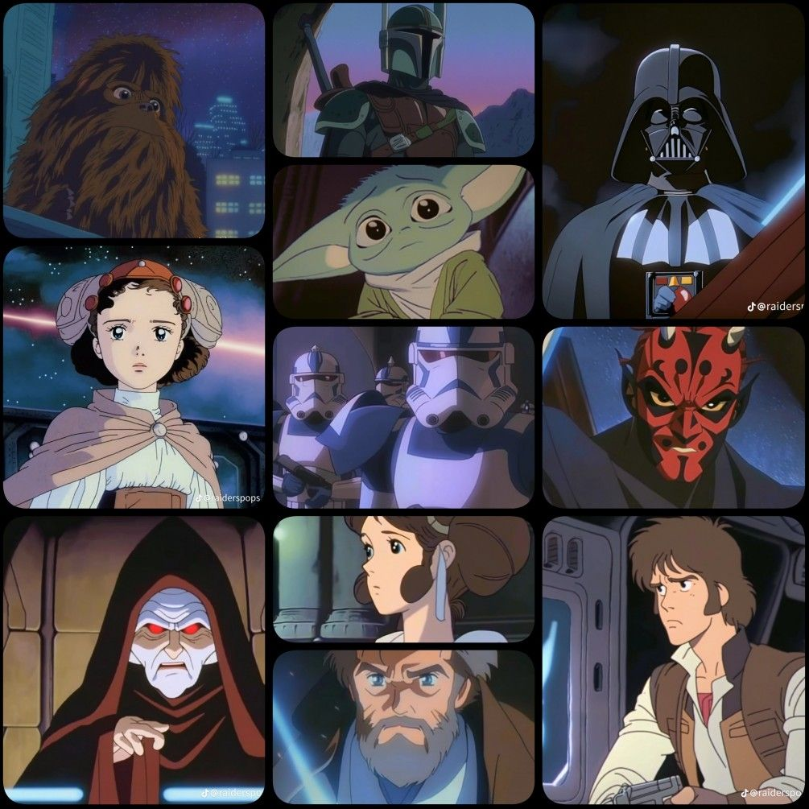
What is Fair Use, Fair Dealing, and Copyright?
Australia’s definitions:
Fair dealing – Australia uses a fair dealing regime (not “fair use”). Limited and purpose-specific exceptions in the Copyright Act 1968 (Cth) allow unlicensed use of a work for research or study (s 40), criticism or review (s 41), parody or satire (s 41A), news reporting (s 42), professional legal advice (s 43) and quotation/other minor cases (s 113E). Whether the dealing is “fair” is judged on factors such as purpose and character, nature of the work, amount taken, market impact and the availability of the work at a normal price (The University of Melbourne 2025).
Copyright infringement – Copyright is infringed when a person, without the owner’s permission, does or authorises in Australia any act reserved to the owner (e.g., reproduce, communicate, perform or adapt) in relation to the whole or a “substantial part” of the work (s 36). Liability also arises for authorising another’s infringement.
Fair Use- focuses on four pillars; purpose, nature, amount, and effect on the market.

Slide 9
Copyright and Legal Exposure
Some lawsuits regarding AI in 2025:
May 6th - Lawsuit vs. Microsoft: Cerence filed a copyright infringement and breach of contract lawsuit against Microsoft and Nuance Communications. The AI-focused lawsuit involves text-to-speech technology (Hickman 2025).
April 25 - Ziff Davis Lawsuit vs OpenAI: Ziff Davis, the parent company of several digital media brands, filed a lawsuit against OpenAI for copyright infringement (Butler, 2025).
March 25 - Meta' Legal Defense: Facebook parent Meta Platforms urged a federal judge to rule its use of protected works to train its AI model is “fair use” under the Copyright Act, and thus didn’t infringe the rights of the authors suing the company, Bloomberg Law reported (Levy 2025).

Slide 10
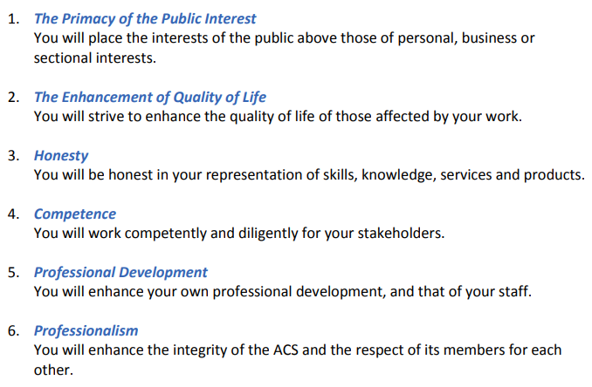
1st Applied Code of Conduct
ACS Code of Professional Conduct (Australian Computer Society 2014)
What Does This Mean?
Each code of conduct can be applied by organisations using generative AI to help ensure its ethical and responsible use.
By aligning practices with established ethical standards, organisations can build user trust, mitigate risks, and promote accountability in developments and deployments of AI technologies.

Slide 11
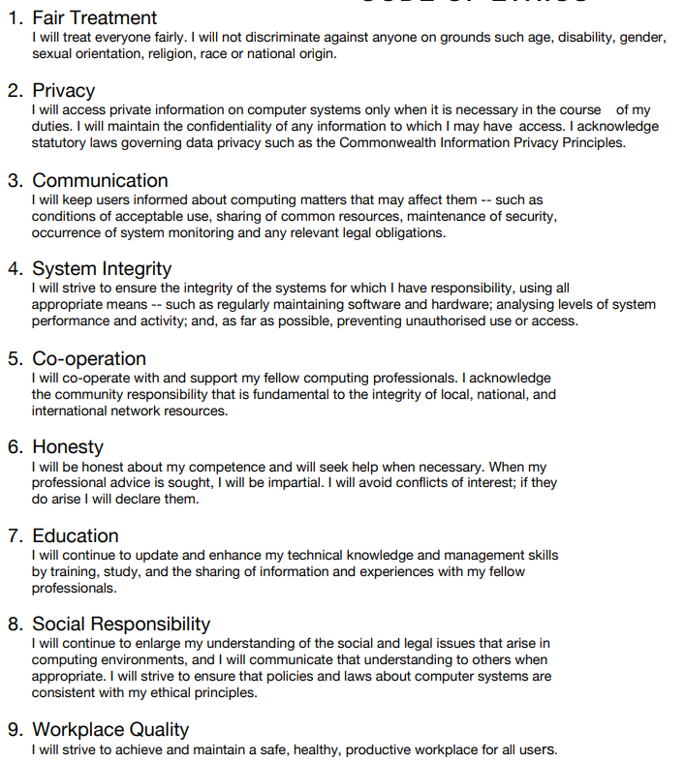
2nd Applied Code of Conduct
Information Technology Professionals Association Code of Ethics (ITPA 2018)
What Does this Mean?
Organisations using generative AI should adopt a more detailed and thorough approach to its implementation.
This ensures that all technologies are applied ethically and responsibly, minimising potential harm and safeguarding the well-being of end users.

Slide 12

Australia’s AI Ethics Principles
(Australian Government Department of Industry, Science and Resources 2024)
Human, societal and environmental wellbeing: AI systems should benefit individuals, society and the environment.
Reliability and safety: AI systems should reliably operate in accordance with their intended purpose.
Human-centred values: AI systems should respect human rights, diversity, and the autonomy of individuals.
Transparency and explainability: There should be transparency and responsible disclosure so people can understand.
Fairness: AI systems should be inclusive and accessible.
Contestability: There should be a timely process to allow people to challenge the use or outcomes of the AI system.
Privacy protection and security: AI systems should respect and uphold privacy rights and data protection, and ensure the security of data.
Accountability: People responsible for the different phases of the AI system lifecycle should be identifiable and accountable.

Slide 13
Ethical Practices For Generative AI
1. Public Interest and Fairness | Use generative AI to promote fairness and the public good, avoiding harmful, misleading, or discriminatory content.
2. Privacy and Confidentiality | Protect individuals' privacy by using only lawful, ethically sourced data in AI systems and complying with the Australian Privacy Principles and relevant laws
3. Transparency and Communication | Clearly inform users when content is AI-generated, remain transparent about its capabilities and limitations, and disclose any risks or biases.
4. Integrity and Accountability | Take responsibility for AI outcomes, avoid deception or plagiarism, and correct errors apparent from AI use.
5. Skills and Competence | Use generative AI within organisation’s level of expertise, stay informed about evolving risks and regulations, and continually update required skills.
6. Security and system Integrity | Safeguard AI systems from misuse or failure, maintain reliability, and protect the broader IT environment from security threats.
7. Collaboration and Cooperation | Encourage teamwork and open discussion regarding ethical AI use, sharing knowledge and solutions across disciplines.
8. Ethic Use Only | Use generative AI solely for legal, ethical, and valid purposes to avoid harmful applications such as surveillance or disinformation.

Slide 14
Prohibited Practices For Generative AI
1. Mislead or Deceive | Avoid using AI to falsify, manipulate, or misrepresent information or content.
2. Violate Privacy | Never expose or misuse personal, sensitive, or identifiable information through AI tools.
3. Use Biased or Discriminatory Data | Refrain from using datasets that perpetuate unfair bias, discrimination, or exclusion.
4. Withhold Transparency | Always disclose when content is AI-generated and clearly communicate its capabilities and limitations.
5. Remove Human Oversight | Avoid delegating high-impact decisions entirely to AI without responsible human intervention.
6. Deploy Unethical Surveillance | Do not use generative AI for unauthorised monitoring, profiling, or exploitative tracking.
7. Ignore Security Risks | Ensure AI systems are protected against misuse, manipulation, or cyber threats.
8. Avoid Accountability | Organisations must not blame AI tools for negative outcomes, full responsibility must be taken for AI use.

Slide 15
Pros Banning Generative AI
Political | Economic | Social | Technological | Environmental | Legal
Ensures compliance with government regulations, such as the Privacy Act and (APPs). Reduces regulatory risk for data breaches or misuse. | Strengthens the human workforce by preserving jobs that can otherwise be automated. Prevents over-reliance, ensuring operational resilience if AI tools become unavailable or costly. | Upholds ethical standards including fairness, honesty, and professional responsibility. Avoids low-quality output, respecting public expectations and ethical frameworks. | Maintains accuracy by avoiding AI-generated misinformation or hallucinations. Low-quality outputs are minimised through reliance on skilled human judgment. Over-reliance on flawed tools is eliminated. | Policy enforcements are simplified in terms of reducing digital wastes and further streamlining compliance resources. Unnecessary computational burdens of large-scale generative models are minimised. | Data and privacy is protected through preventing unauthorised AI-driven data processing. IP data is safeguarded by avoidance of infringement risks from AI-generated derivatives. Ensures data security and copyright laws compliance.

Slide 16
Cons Banning Generative AI
Political | Economic | Social | Technological | Environmental | Legal
Limited freedom viewed as authoritarian control, increasing tension with companies and innovators. Risk of falling behind global powers that are invested in AI and reduced influence in global tech policy. | Great risk for finance and marketing causing loss of competitiveness. Increased foreign reliance and decline in AI related job creation with reduced foreign investment. | Immediate public backlash and may cause tech divide. Reduced access to helpful tools. Risk of AI development move under illegal or unregulated means. | Stagnant innovation especially under automation, creative tools, research and development. Hindered development of adaptation and ethical alignment forcing tech talent or giants to migrate. | Missed opportunities under machine learning. Reduced advances in environmental monitoring, research, and sustainable or optimised climate actions. | Rise of unregulated use and oversight. Difficulty in regulation, enforcement, and censorship challenges.

Slide 17

Summarisation Of Key Information
In Australia, generative AI must follow fair dealing and copyright laws to minimise infringement and legal risk for users and developers.
Organisations must create industry-specific codes to guide ethical generative AI use.
Existing frameworks like the ACS and ITPA codes guide ethical organisational conduct for past, current, and emerging technologies, including generative AI in ICT.
Australia’s 8 AI ethics principles help organisations achieve safer, fairer, and more reliable AI use through reducing harm and upholding ethics.
The 8 ethical practices guide responsible AI use.
The 8 prohibited practices help prevent AI misuse.

Slide 18

What Should Organisations Do With Generative AI?
Generative AI must not have authority over humans for major decisions because it lacks human judgment and empathy.
Example; AI sentencing in criminal justice risks bias and unfairness without human oversight
Organisations must implement customised generative AI frameworks to ensure ethical treatment of end-users.
This technological shift is inevitable for many organisations and must be ethically and legally adapted in a way that ensures appropriate use and intent.

Slide 19
Reference List
AI, Data & Analytics Network 2022, Inside Mayo Clinic’s AI Factory | AI, Data & Analytics Network, AI, Data & Analytics Network, viewed 16 May 2025, <https://www.aidataanalytics.network/data-science-ai/articles/inside-mayo-clinics-ai-factory>.
Alyve 2024, Alyve’s List of Generative AI Adoption in Business Case Studies, Alyve, viewed 16 May 2025, <https://www.alyve.com.au/case-studies-of-generative-ai-adoption-in-business>.
Australian Computer Society 2014, ACS Code of Professional Conduct Professional Standards Board Australian Computer Society, 4 April, pp. 1–8.
Australian Government Department of Industry, Science and Resources 2024, Australia’s AI Ethics Principles, Industry.gov.au.
Butler, M. (2025) ‘OpenAI hit with copyright lawsuit by digital media giant Ziff Davis’, Courthouse News Service, 25 April. Available at: https://www.courthousenews.com/openai-hit-with-copyright-lawsuit-by-digital-media-giant-ziff-davis/ (Accessed: 23 May 2025).
Hickman, K 2025, Cerence AI Files Copyright Infringement Suit Against Microsoft and Nuance | Cerence AI, Cerence AI, viewed 23 May 2025, <https://www.cerence.com/news-releases/news-release-details/cerence-ai-files-copyright-infringement-suit-against-microsoft>.

Slide 20
Reference List
ITPA 2018, Code of Ethics | Australia |, Information Technology Professionals Association, viewed 21 May 2025, <https://www.itpa.org.au/code-of-ethics/>.
Levy, A 2025, Meta Seeks ‘Fair Use’ Ruling in Authors’ AI Copyright Lawsuit, Bloomberg Law, viewed 23 May 2025, <https://news.bloomberglaw.com/ip-law/meta-seeks-fair-use-ruling-in-authors-ai-copyright-lawsuit>.
McKinsey & Company 2025, Empowering telecom employees with personalized AI-powered training and coaching tools, McKinsey & Company, viewed 16 May 2025, <https://www.mckinsey.com/industries/technology-media-and-telecommunications/how-we-help-clients/empowering-telecom-employees-with-personalized-ai-powered-training-and-coaching-tools>.
Nelu, C 2024, Exploitation of Generative AI by Terrorist Groups, International Centre for Counter-Terrorism - ICCT, viewed 16 May 2025, <https://icct.nl/publication/exploitation-generative-ai-terrorist-groups>.
Olavsrud, T 2022, 12 famous AI disasters, CIO, viewed 16 May 2025, <https://www.cio.com/article/190888/5-famous-analytics-and-ai-disasters.html>.
The University of Melbourne 2025, Fair dealing, Copyright, viewed 22 May 2025, <https://copyright.unimelb.edu.au/shared/using-copyright-material/fair-dealing?utm_source=chatgpt.com>.

